Slide 1
Exploring Cognitive Services
[ speaker name]
[ speaker contact methods ]
Notes:
Put your details above.
Each slide contains example script in the notes. Once confident with the content, you can use the headings in the notes as cues to ad-lib the content in your own words.

Slide 2
What are Cognitive Services?
Cognitive services are a set of APIs that are designed to democratize artificial intelligence by enabling systems to see, hear, speak, understand and interpret our needs using natural methods of communication.
What these services generally do is bring structured semantic data to human knowledge I/O with a degree of confidence
Notes:
CLICK
Read/summarize description
Read simplified explanation
We want the machine to draw out those semantics and tell us with what degree of confidence, those semantic interpretations are correct. And if we can get some structured data values or entities in and out then even better.

Slide 3
The Cognitive Services
Vision | Speech | Language | Knowledge | Search
Computer Vision Content Moderator Emotion Face Video | Bing Speech Custom Speech Service Speaker Recognition | Bing Spell Check Language Understanding Linguistic Analysis Text Analytics Translator WebLM | Academic Entity Linking Knowledge Exploration QnA Maker Recommendations | Bing Autosuggest Bing Image Search Bing News Search Bing Video Search Bing Web Search
Notes:
Here’s the far ranging list of cognitive services.
In this session we’ll delve into sample of these and see how they are used, including some which are part of our researcher scenario using 5 services.

Slide 4
Services Demonstrated
Speech – Speech To Text & Text To Speech
Search – Bing Image Search
Language – Linguistic Analysis
Vision – Facial Emotion
Knowledge – QnA (bot) maker
Language – LUIS
Notes:
So let’s look at which service APIs we are going to look at over 6 demos.
List them
We’ll end with a look at LUIS, one of the most powerful services.

Slide 5
Researcher Solution
Request a picture of a thing or person (with a specific emotion) by voice
Determine intent for thing or person
Get image to display
Find emotions of person in picture
Be told the highest emotion and confidence
STT
LUIS
Image Search
Emotion
TTS
“A picture of Satya Nadella happy”
This is x% about a thing/person
Image of person
Emotional readings
“x% sure that this person is [highest emotion]”
Notes:
Let’s recap the researcher scenario
CLICK – Bing Speech Speech To Text aka Speech Recognition.
This gets us the text of what was spoken and then we pass that to…
CLICK – Language Understanding Intelligent Service (or LUIS)
To get which intent was present and the degree of confidence
CLICK – Bing Image Search
We then search for matching images and we take the first one, and then if the predominant intent was for a person (vs. a thing), we also then pass the image to…
CLICK – Emotion API
Which gives us all the emotion ratings
CLICK – Bing Speech Text to Speech
We find the highest rated emotion and we speak about that

Slide 6
Speech – Speech To Text
Request a picture of a thing or person (with a specific emotion) by voice
Determine intent for thing or person
Get image to display
Find emotions of person in picture
Be told the highest emotion and confidence
STT
LUIS
Image Search
Emotion
TTS
“A picture of Satya Nadella happy”
This is x% about a thing/person
Image of person
Emotional readings
“x% sure that this person is [highest emotion]”
Notes:
Let’s get started.
First, let’s look at how to do speech to text (aka Speech Recognition) and text to speech

Slide 7
Demo
Speech to text and back again
Notes:
Demo 2.1

Slide 8
Search – Bing Image Search
Request a picture of a thing or person (with a specific emotion) by voice
Determine intent for thing or person
Get image to display
Find emotions of person in picture
Be told the highest emotion and confidence
STT
LUIS
Image Search
Emotion
TTS
“A picture of Satya Nadella happy”
This is x% about a thing/person
Image of person
Emotional readings
“x% sure that this person is [highest emotion]”
Notes:
So we are now able to listen to the user, convert it to text do something with that text and output text results out as speech.
Moving on, we’ll skip LUIS for now and come back to it at the end. Now, let’s see how to see Bing Image Search

Slide 9
Demo
Bing Image Search
Notes:
Demo 2.2

Slide 10
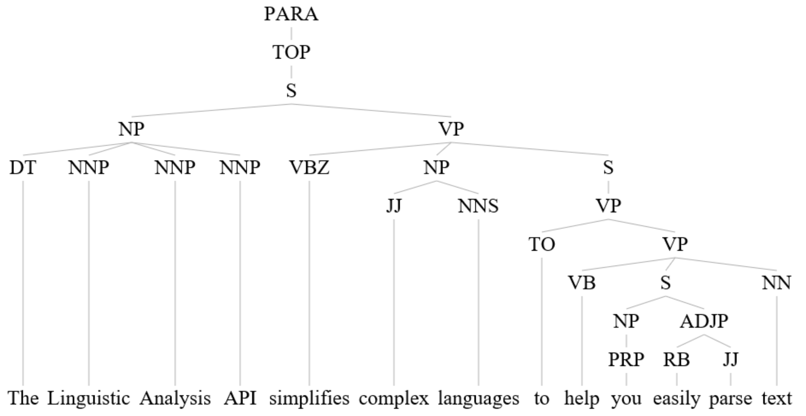
Language – Linguistic Analysis
Notes:
So it’s easier for us to get URLs to image matching search text. We can get several or just use one in our scenario.
While note related to the researcher scenario, linguistic analysis is a powerful tool for deconstructing text. It breaks down a sentence and can be used to aid in natural language interpretation and processing.

Slide 11
Demo
Linguistic Analysis
Notes:
Demo 2.3

Slide 12
Vision – Facial Emotion
Request a picture of a thing or person (with a specific emotion) by voice
Determine intent for thing or person
Get image to display
Find emotions of person in picture
Be told the highest emotion and confidence
STT
LUIS
Image Search
Emotion
TTS
“A picture of Satya Nadella happy”
This is x% about a thing/person
Image of person
Emotional readings
“x% sure that this person is [highest emotion]”
Notes:
Back to the research scenario in the event that we want to search for an image of a person. Once we get an image, we want to assess the emotions present.

Slide 13
Demo
Facial Emotion
Notes:
Demo 2.4

Slide 14

Knowledge – QnA (bot) maker
Notes:
So that’s emotion in place.
Before ending with LUIS, let’s take a look at one of the really commercial useful Knowledge-related APIs – the QnA maker.

Slide 15
Demo
QnA Maker
Notes:
Demo 2.5

Slide 16
Language - LUIS
Request a picture of a thing or person (with a specific emotion) by voice
Determine intent for thing or person
Get image to display
Find emotions of person in picture
Be told the highest emotion and confidence
STT
LUIS
Image Search
Emotion
TTS
“A picture of Satya Nadella happy”
This is x% about a thing/person
Image of person
Emotional readings
“x% sure that this person is [highest emotion]”
Notes:
Now let’s see how to get started with LUIS, the Language Understanding Intelligence Services. In this case we want to determine if the words spoken and converted to text, convey a request about a person or a thing.

Slide 17
Demo
LUIS in the researcher app
Notes:
Demo 2.6

Slide 18
Resources
Learn and try at - https://www.microsoft.com/cognitive-services
Docs & getting started - https://docs.microsoft.com/en-us/azure/cognitive-services/
Cognitive Services example code - https://github.com/Microsoft/Cognitive-Samples-IntelligentKiosk
Notes:
That concluded our demos, completing the chain of 5 services used together and selectively depending on the intent of the user.
Discuss Resource shown

